Slide 1

Introduction to UML:
Structural and Use Case Modeling
Object Modeling with OMG UML Tutorial Series
Cris Kobryn
Co-Chair UML Revision Task Force
© 1999-2001 OMG and Contributors: Crossmeta, EDS, IBM, Enea Data, Hewlett-Packard, IntelliCorp, Kabira Technologies, Klasse Objecten, Rational Software, Telelogic, Unisys

Slide 2
Overview
Tutorial series
Quick tour
Structural modeling
Use case modeling

Slide 3
Tutorial Series
Lecture 1: Introduction to UML: Structural and Use Case Modeling
Lecture 2: Behavioral Modeling with UML
Lecture 3: Advanced Modeling with UML
[Note: This version of the tutorial series is based on OMG UML Specification v. 1.4, UML Revision Task Force recommended final draft, OMG doc# ad/01-02-13.]

Slide 4
Tutorial Goals
What you will learn:
  what the UML is and what is it not
  UML’s basic constructs, rules and diagram techniques
  how the UML can model large, complex systems
  how the UML can specify systems in an implementation-independent manner
  how UML, XMI and MOF can facilitate metadata integration
What you will not learn:
  Object Modeling 101
  object methods or processes
  Metamodeling 101

Slide 5
Quick Tour
Why do we model?
What is the UML?
Foundation elements
Unifying concepts
Language architecture
Relation to other OMG technologies

Slide 6
Why do we model?
Provide structure for problem solving
Experiment to explore multiple solutions
Furnish abstractions to manage complexity
Reduce time-to-market for business problem solutions
Decrease development costs
Manage the risk of mistakes

Slide 7
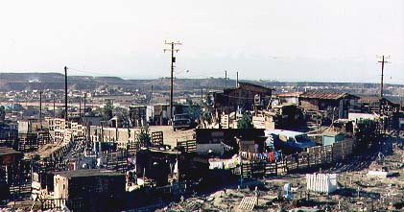
The Challenge
Tijuana “shantytown”: http://www.macalester.edu/~jschatz/residential.html

Slide 8

The Vision
Fallingwater:
http://www.adelaide.net.au/~jpolias/FLW/Images/FallingWater.jpeg

Slide 9
Why do we model graphically?
Graphics reveal data.
  Edward Tufte
  The Visual Display of Quantitative Information, 1983
1 bitmap = 1 megaword.
  Anonymous visual modeler

Slide 10
Quick Tour
The UML is a graphical language for
  specifying
  visualizing
  constructing
  documenting
the artifacts of software systems
Added to the list of OMG adopted technologies in November 1997 as UML 1.1
Most recent minor revision is UML 1.3, adopted in November 1999
Next minor revision will be UML 1.4, planned to be adopted in Q2 2001
Next major revision will be UML 2.0, planned to be completed in 2002

Slide 11
UML Goals
Define an easy-to-learn but semantically rich visual modeling language
Unify the Booch, OMT, and Objectory modeling languages
Include ideas from other modeling languages
Incorporate industry best practices
Address contemporary software development issues
  scale, distribution, concurrency, executability, etc.
Provide flexibility for applying different processes
Enable model interchange and define repository interfaces

Slide 12
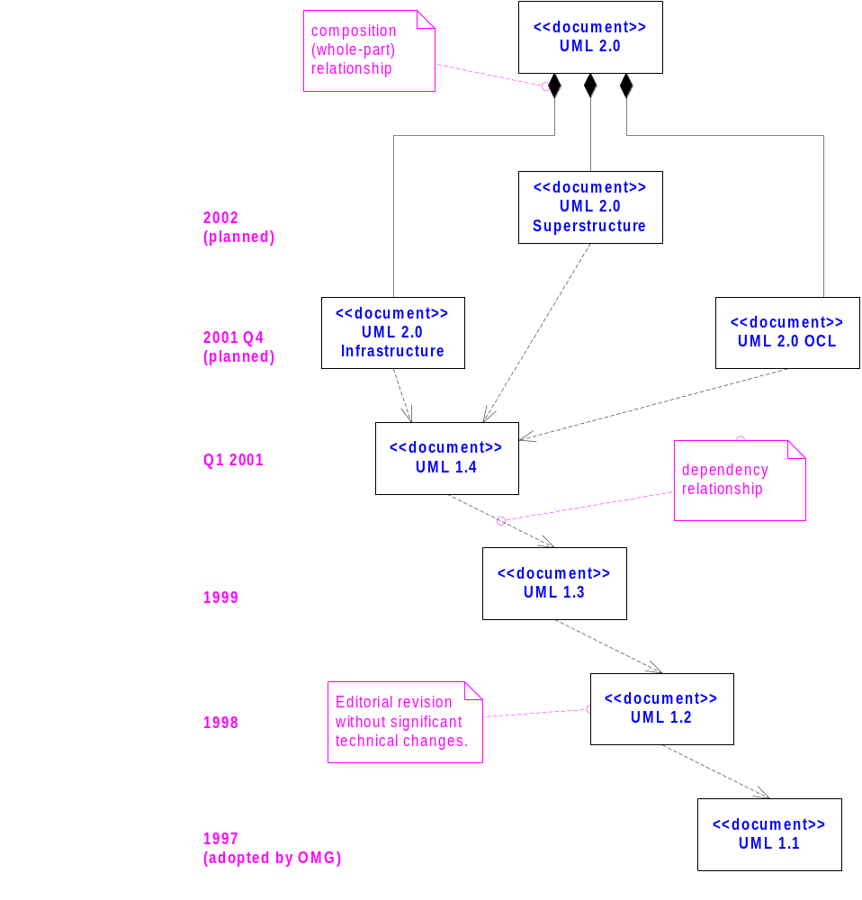
OMG UML Evolution
From [Kobryn 01a].

Slide 13
OMG UML Contributors
Aonix
Colorado State University
Computer Associates
Concept Five
Data Access
EDS
Enea Data
Hewlett-Packard
IBM
I-Logix
InLine Software
Intellicorp
Kabira Technologies
Klasse Objecten
Lockheed Martin
Microsoft
ObjecTime
Oracle
Ptech
OAO Technology Solutions
Rational Software
Reich
SAP
Softeam
Sterling Software
Sun
Taskon
Telelogic
Unisys
…

Slide 14
OMG UML 1.4 Specification
UML Summary
UML Semantics
UML Notation Guide
UML Example Profiles
  Software Development Processes
  Business Modeling
Model Interchange
  Model Interchange Using XMI
  Model Interchange Using CORBA IDL
Object Constraint Language

Slide 15
Tutorial Focus: the Language
language = syntax + semantics
  syntax = rules by which language elements (e.g., words) are assembled into expressions (e.g., phrases, clauses)
  semantics = rules by which syntactic expressions are assigned meanings
UML Notation Guide – defines UML’s graphic syntax
UML Semantics – defines UML’s semantics

Slide 16
Foundation Concepts
Building blocks
Well-formedness rules

Slide 17
Building Blocks
The basic building blocks of UML are:
  model elements (classes, interfaces, components, use cases, etc.)
  relationships (associations, generalization, dependencies, etc.)
  diagrams (class diagrams, use case diagrams, interaction diagrams, etc.)
Simple building blocks are used to create large, complex structures
  cf. elements, bonds and molecules in chemistry
  cf. components, connectors and circuit boards in hardware

Slide 18
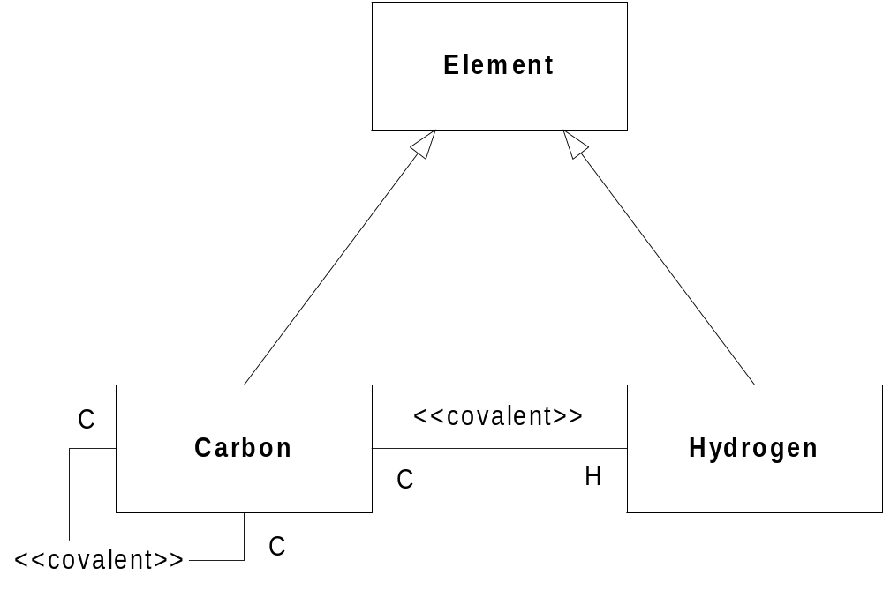
Diagram: Classifier View

Slide 19
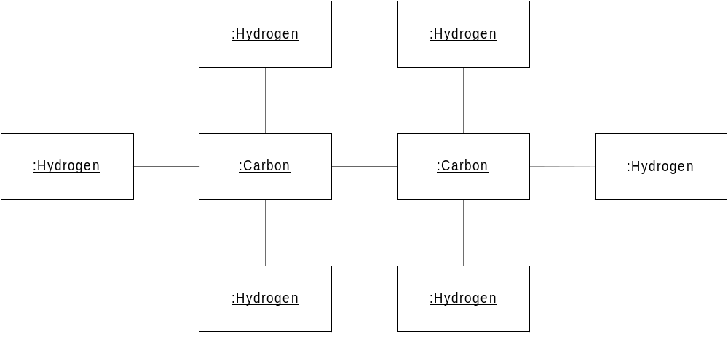
Diagram: Instance View

Slide 20
Well-Formedness Rules
Well-formed: indicates that a model or model fragment adheres to all semantic and syntactic rules that apply to it.
UML specifies rules for:
    naming
    scoping
    visibility
    integrity
    execution (limited)
However, during iterative, incremental development it is expected that models will be incomplete and inconsistent.

Slide 21
Well-Formedness Rules (cont’d)
Example of semantic rule: Class [1]
    English: If a Class is concrete, all the Operations of the Class should have a realizing Method in the full descriptor.
    OCL: not self.isAbstract implies self.allOperations->
    forAll (op | self.allMethods->
    exists (m | m.specification-> includes(op)))

Slide 22
Well-Formedness Rules (cont’d)
Example of syntactic rules: Class
    Basic Notation: A class is drawn as a solid-outline rectangle with three compartments separated by horizontal lines.
    Presentation Option: Either or both of the attribute and operation compartments may be suppressed.
Example of syntactic guideline: Class
    Style Guideline: Begin class names with an uppercase letter.

Slide 23
Unifying Concepts
classifier-instance dichotomy
  e.g., an object is an instance of a class OR
  a class is the classifier of an object
specification-realization dichotomy
  e.g., an interface is a specification of a class OR
  a class is a realization of an interface
analysis-time vs. design-time vs. run-time
  modeling phases (“process creep”)
  usage guidelines suggested, not enforced

Slide 24
Language Architecture
Metamodel architecture
Package structure

Slide 25
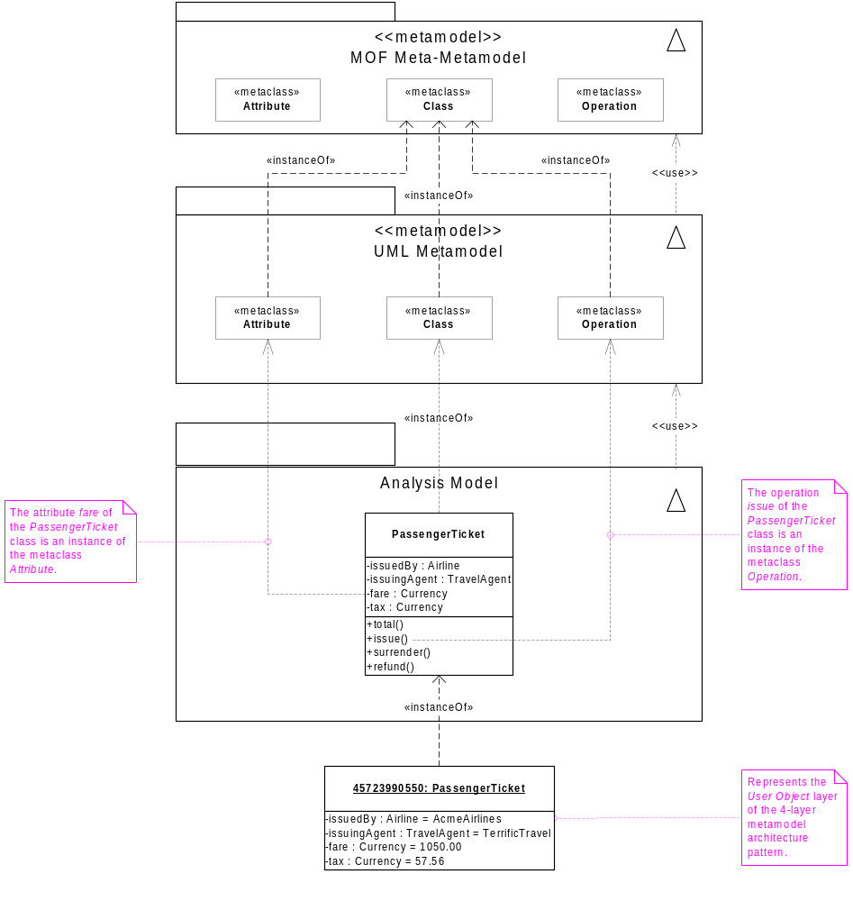
Metamodel Architecture
From [Kobryn 01b].

Slide 26
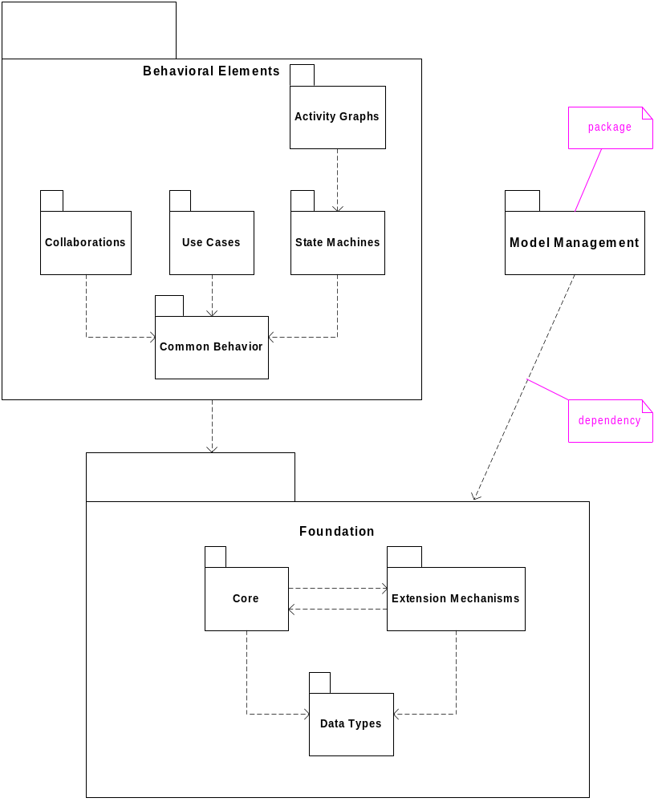
UML Metamodel Layer
From [Kobryn 01b].

Slide 27
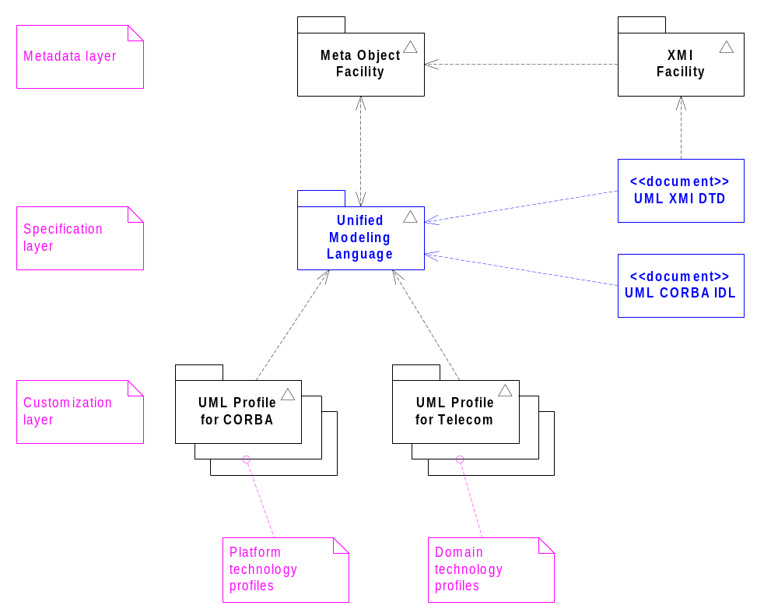
Relationships to Other Modeling Technologies
From [Kobryn 01b].

Slide 28
Structural Modeling
What is structural modeling?
Core concepts
Diagram tour
When to model structure
Modeling tips
Example: Interface-based design

Slide 29
What is structural modeling?
Structural model: a view of an system that emphasizes the structure of the objects, including their classifiers, relationships, attributes and operations.

Slide 30
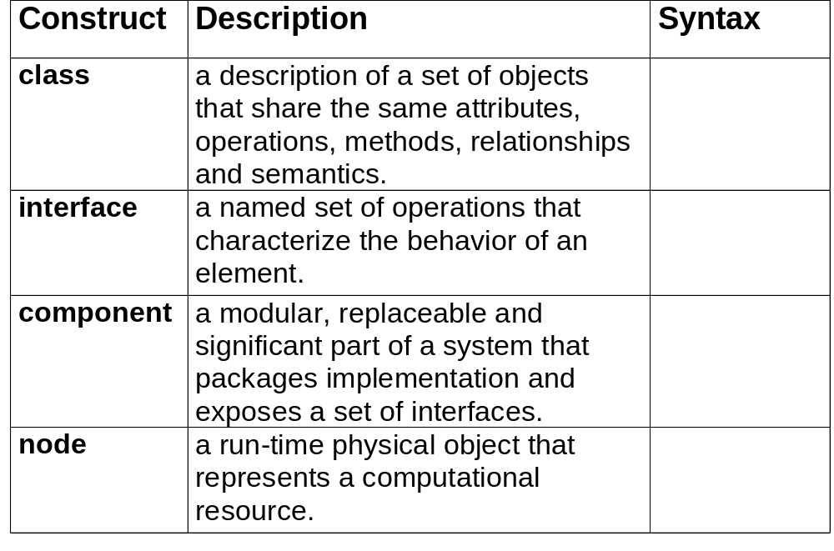
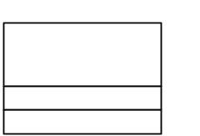

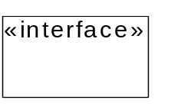
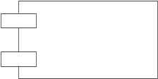
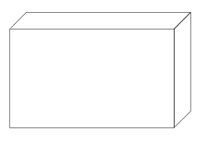
Structural Modeling: Core Elements

Slide 31
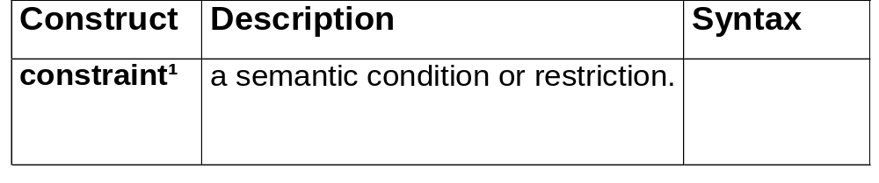
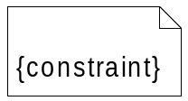
Structural Modeling: Core Elements (cont’d)
¹ An extension mechanism useful for specifying structural elements.

Slide 32
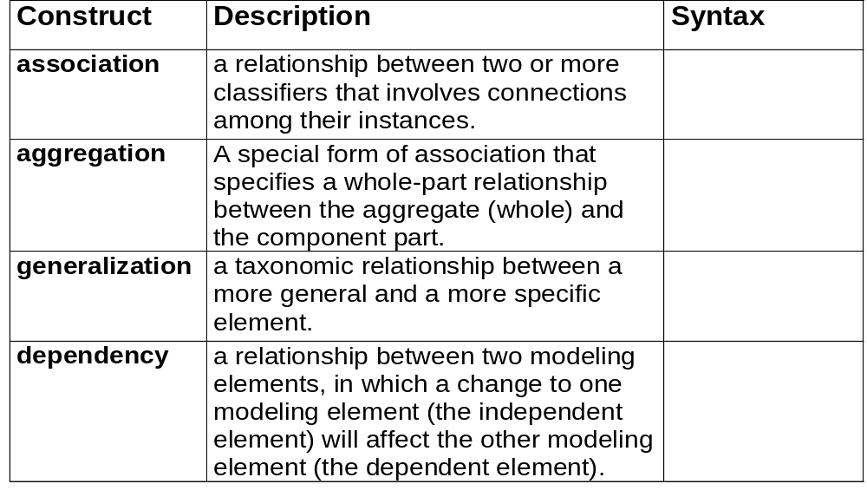
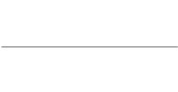




Structural Modeling: Core Relationships

Slide 33
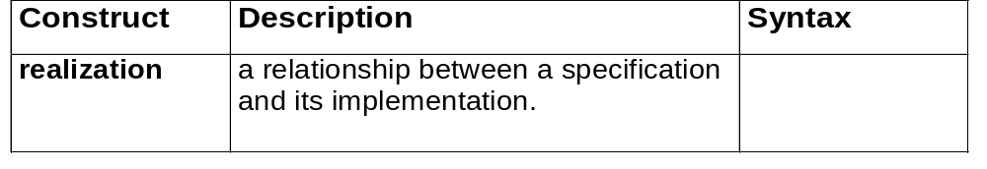

Structural Modeling: Core Relationships (cont’d)

Slide 34
Structural Diagram Tour
Show the static structure of the model
  the entities that exist (e.g., classes, interfaces, components, nodes)
  internal structure
  relationship to other entities
Do not show
  temporal information
Kinds
  static structural diagrams
    class diagram
    object diagram
  implementation diagrams
    component diagram
    deployment diagram

Slide 35
Static Structural Diagrams
Shows a graph of classifier elements connected by static relationships.
kinds
  class diagram: classifier view
  object diagram: instance view

Slide 36
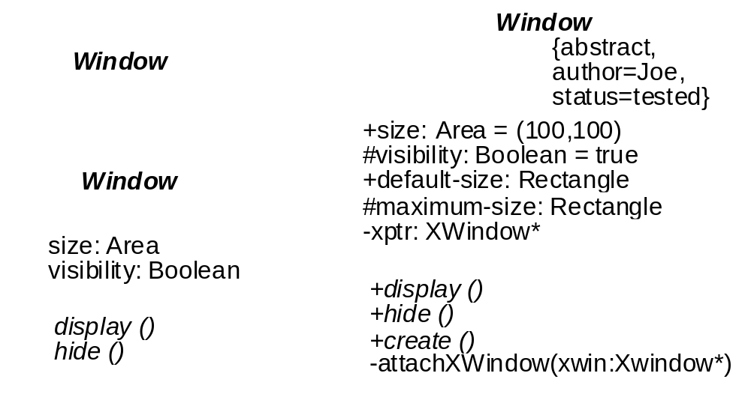
Classes
Fig. 3-20, UML Notation Guide

Slide 37
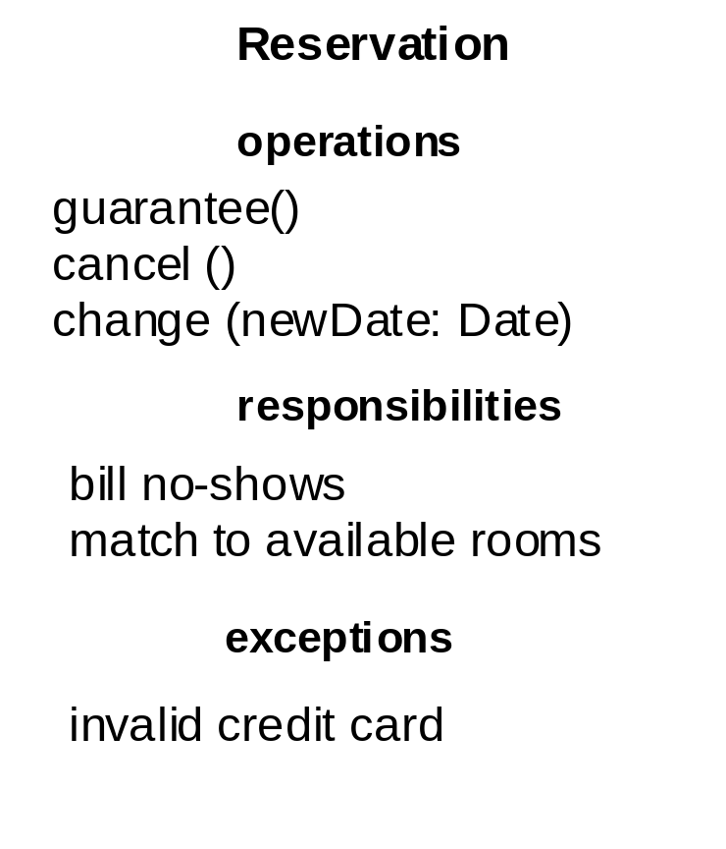
Classes: compartments with names
Fig. 3-23, UML Notation Guide

Slide 38
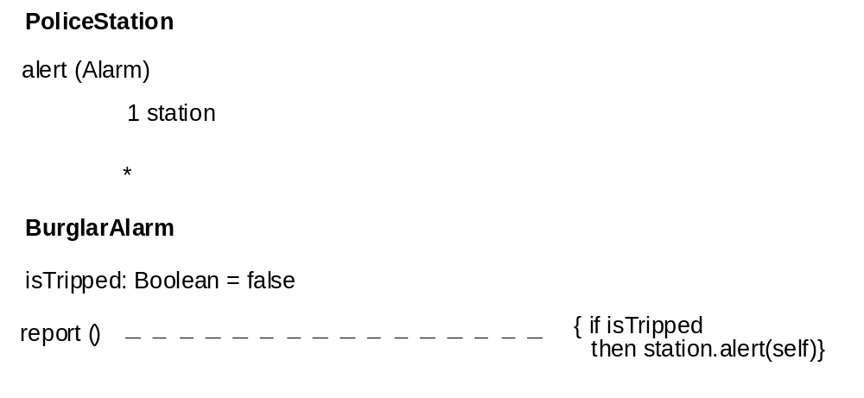
Classes: method body
Fig. 3-24, UML Notation Guide

Slide 39
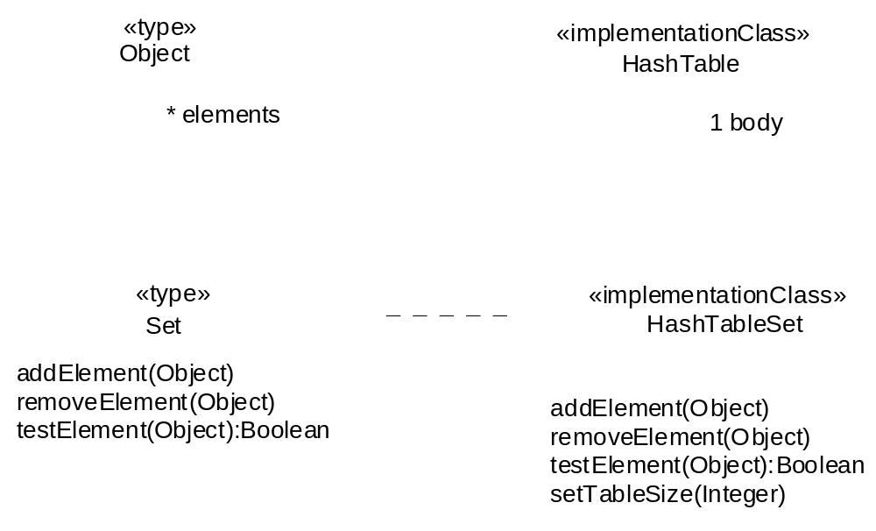
Types and Implementation Classes
Fig. 3-27, UML Notation Guide

Slide 40
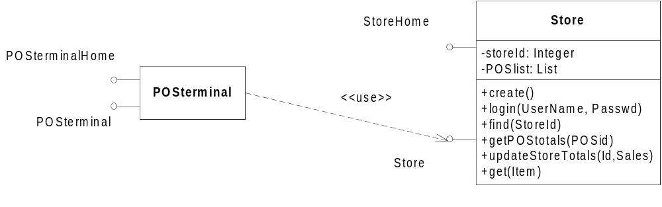
Interfaces: Shorthand Notation
Fig. 3-29, UML Notation Guide

Slide 41
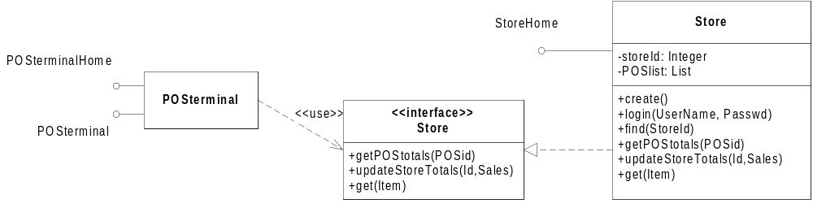
Interfaces: Longhand Notation
Fig. 3-29, UML Notation Guide

Slide 42
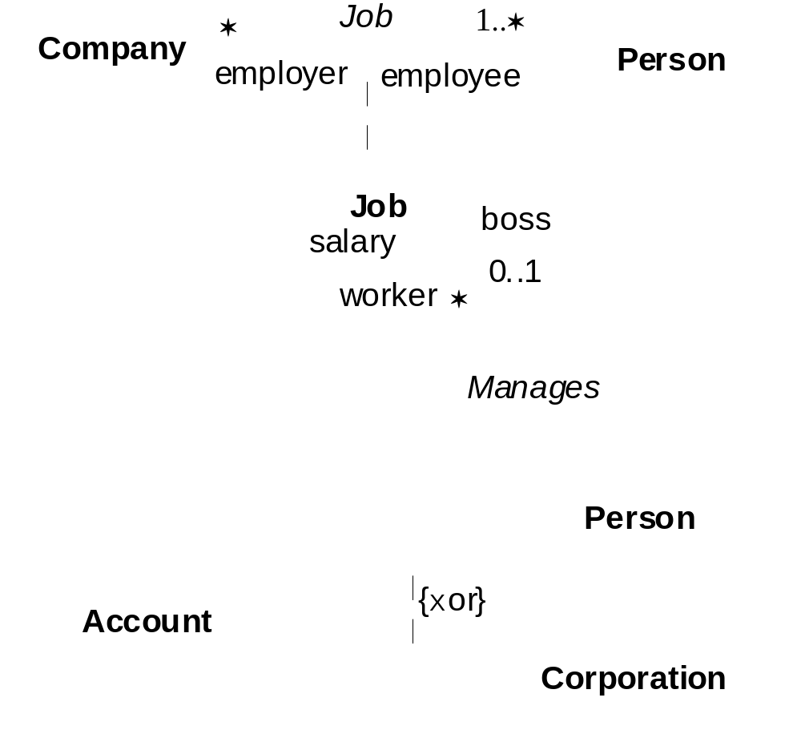
Associations
Fig. 3-40, UML Notation Guide

Slide 43
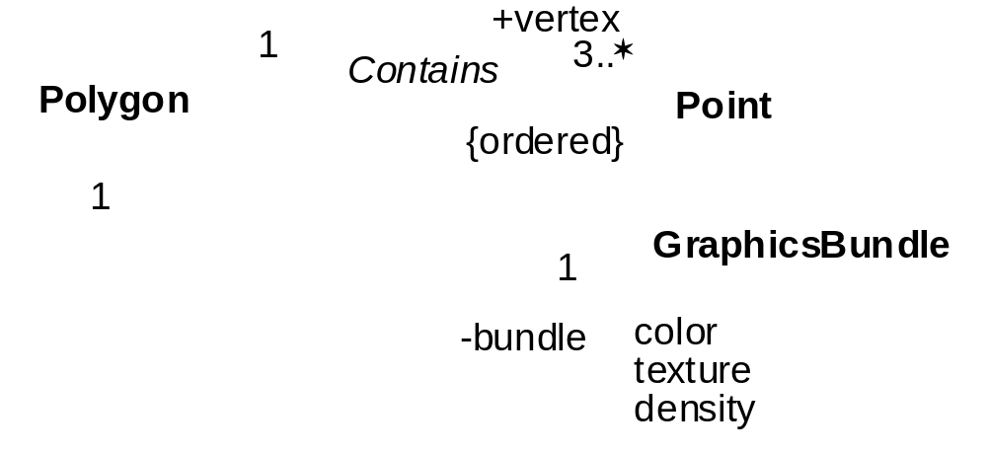
Association Ends
Fig. 3-41, UML Notation Guide

Slide 44
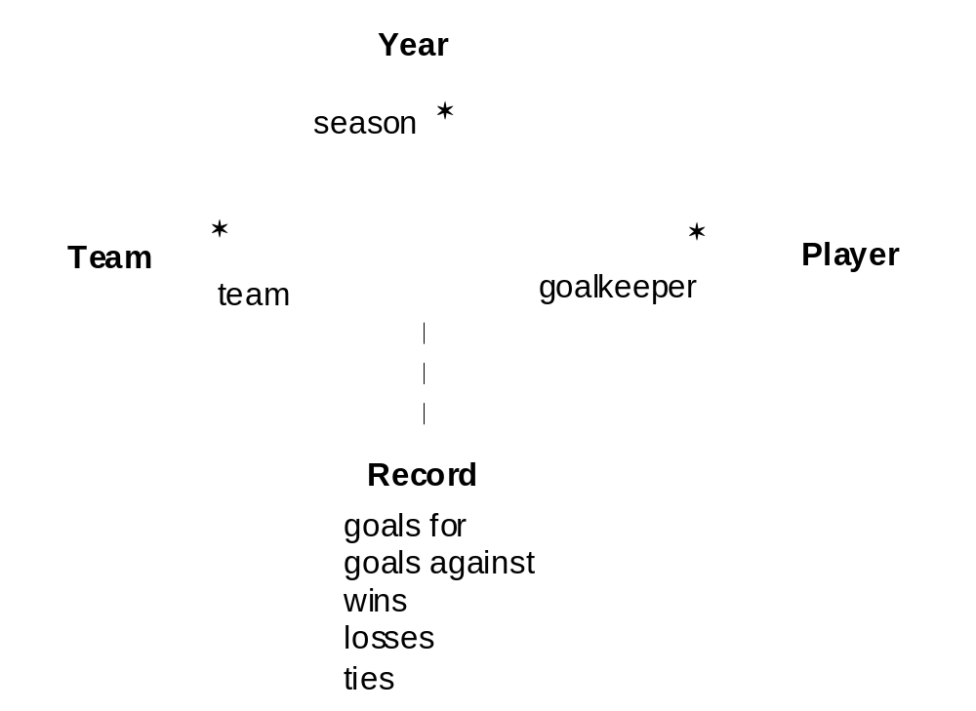
Ternary Associations
Fig. 3-44, UML Notation Guide

Slide 45
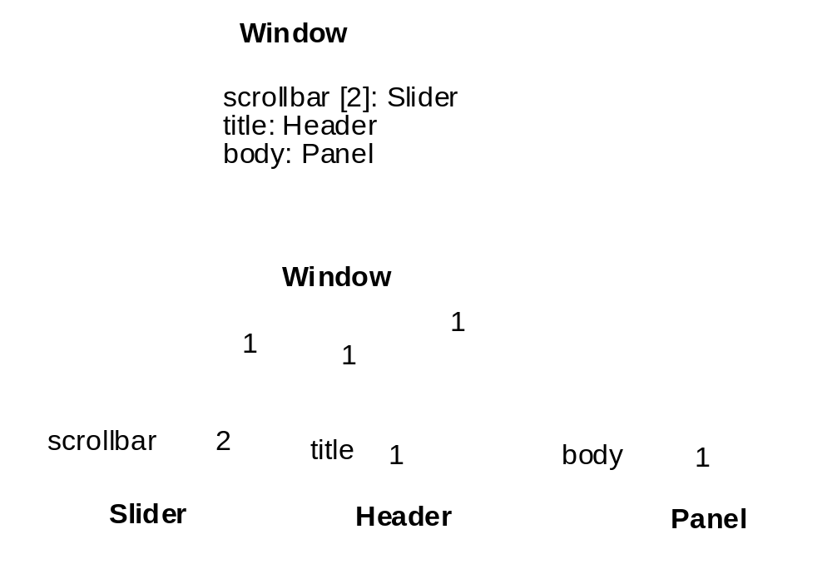
Composition
Fig. 3-45, UML Notation Guide

Slide 46
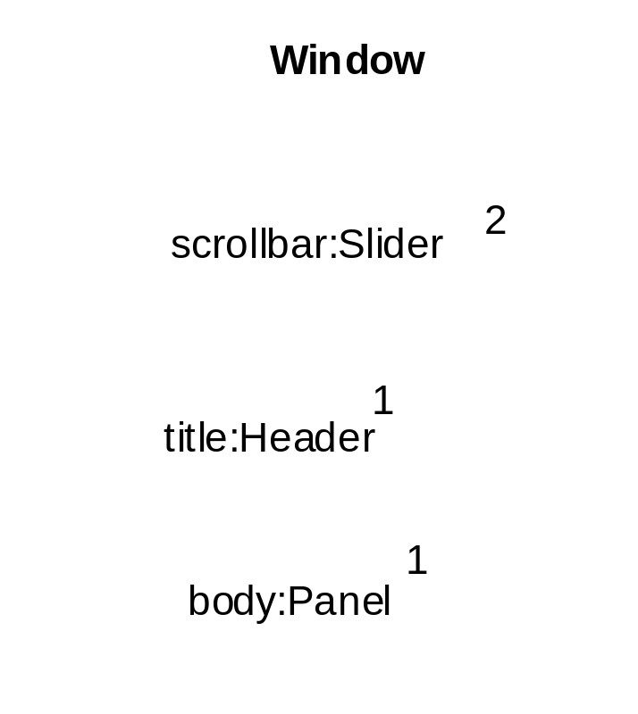
Composition (cont’d)
Fig. 3-45, UML Notation Guide

Slide 47
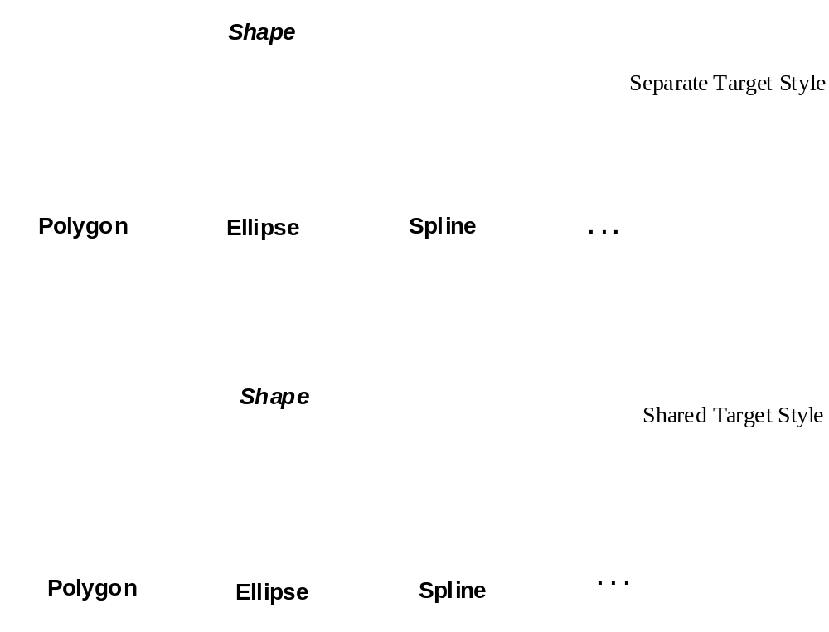
Generalization
Fig. 3-47, UML Notation Guide

Slide 48
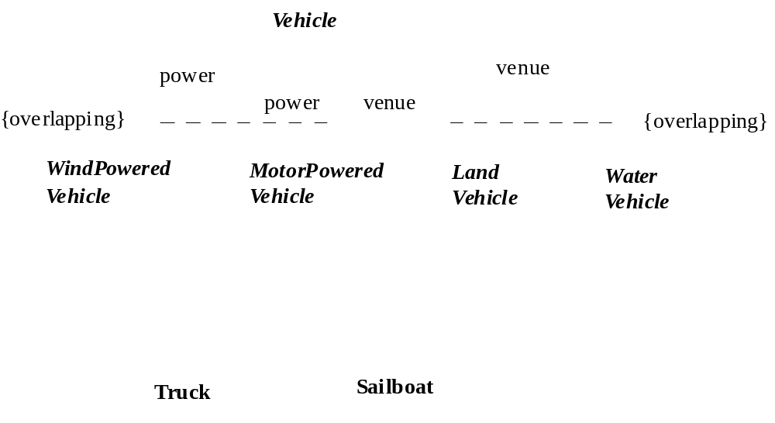
Generalization
Fig. 3-48, UML Notation Guide

Slide 49
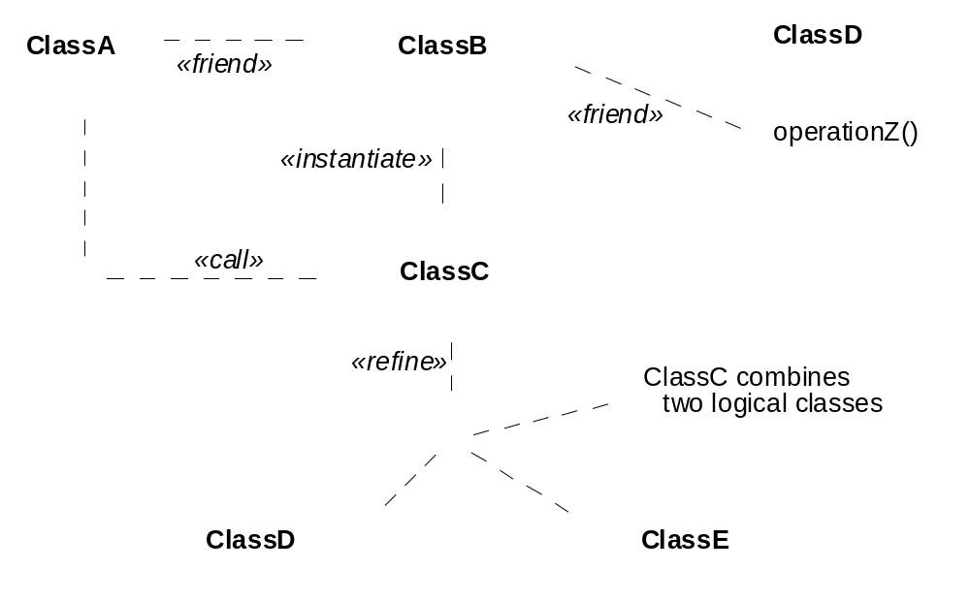
Dependencies
Fig. 3-50, UML Notation Guide

Slide 50
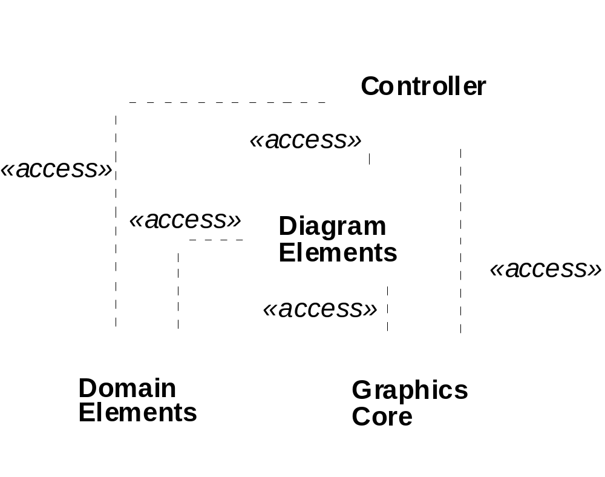
Dependencies
Fig. 3-51, UML Notation Guide

Slide 51
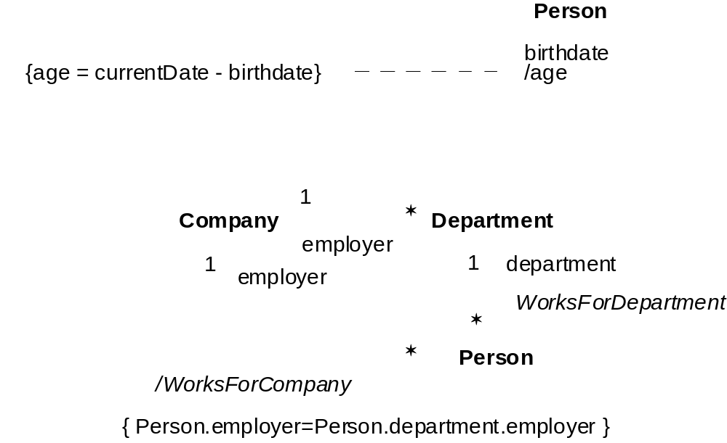
Derived Attributes and Associations
Fig. 3-52, UML Notation Guide

Slide 52
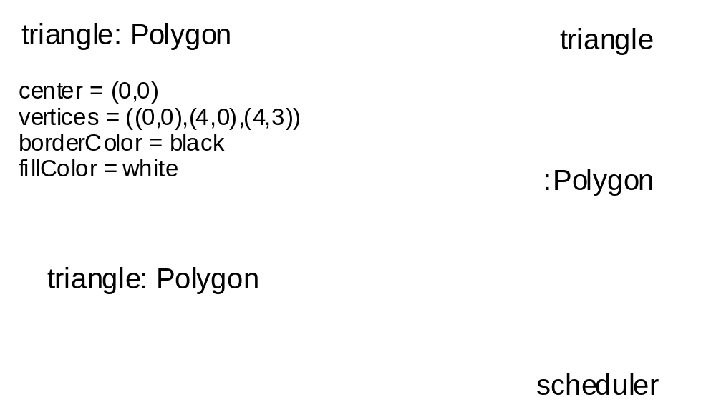
Objects
Fig. 3-38, UML Notation Guide

Slide 53
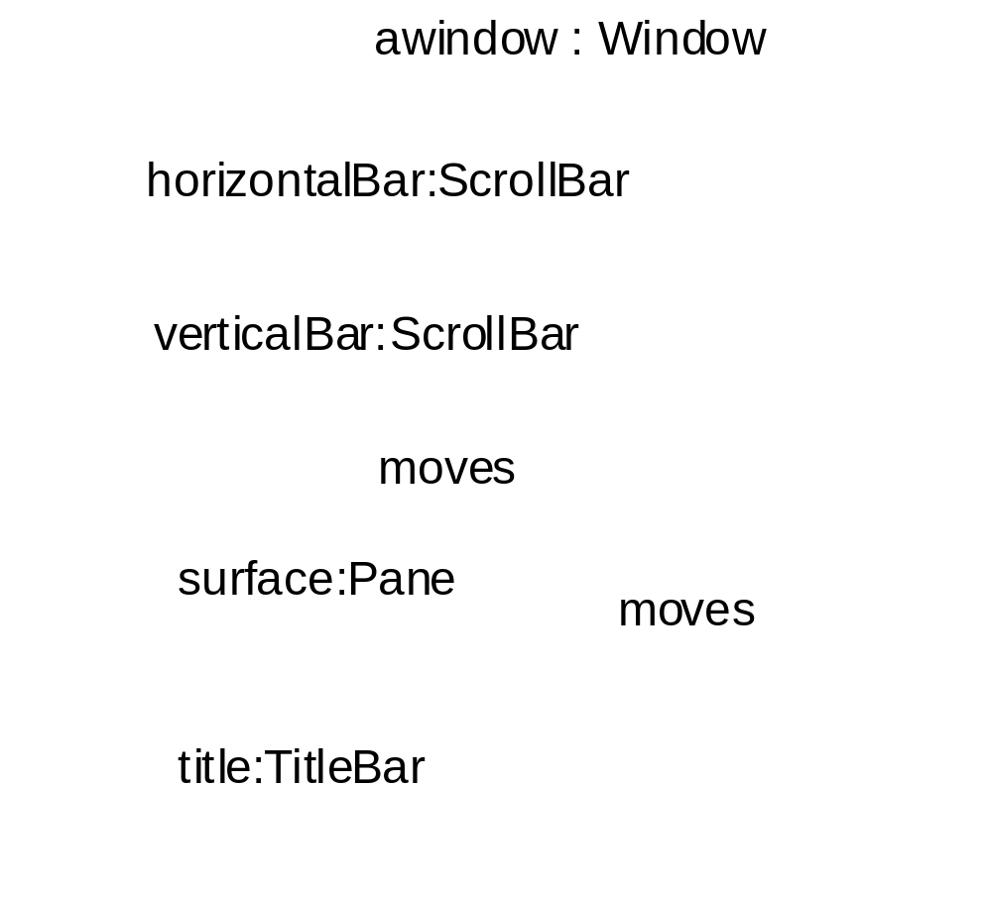
Composite objects
Fig. 3-39, UML Notation Guide

Slide 54
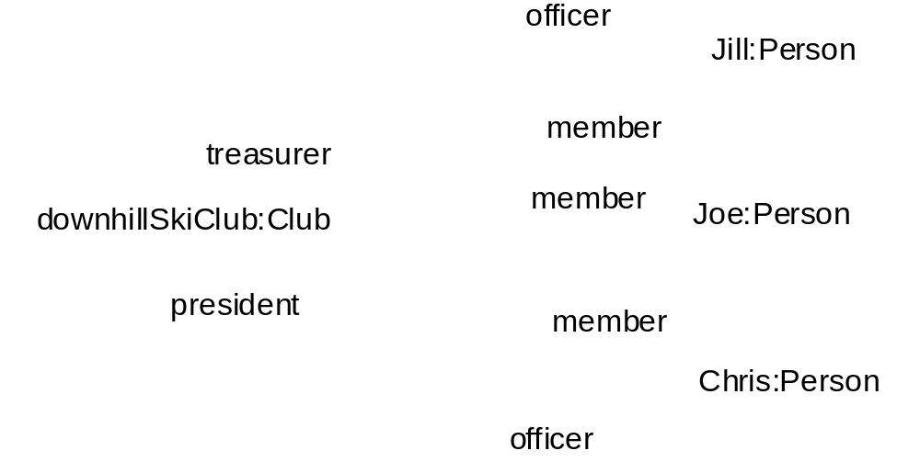
Links
Fig. 3-46, UML Notation Guide

Slide 55
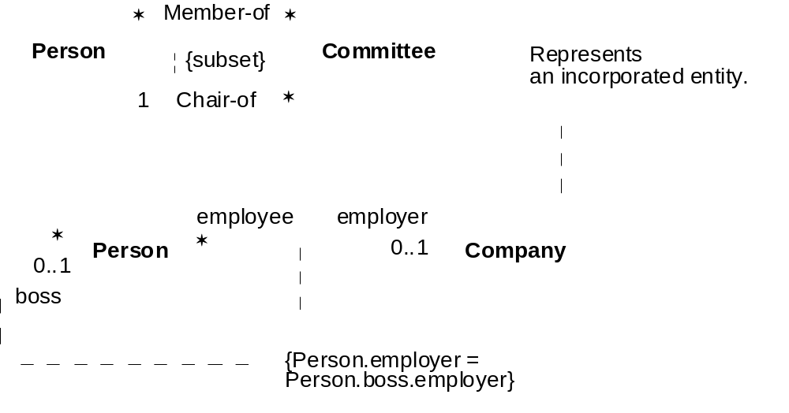
Constraints and Comments
Fig. 3-17, UML Notation Guide

Slide 56
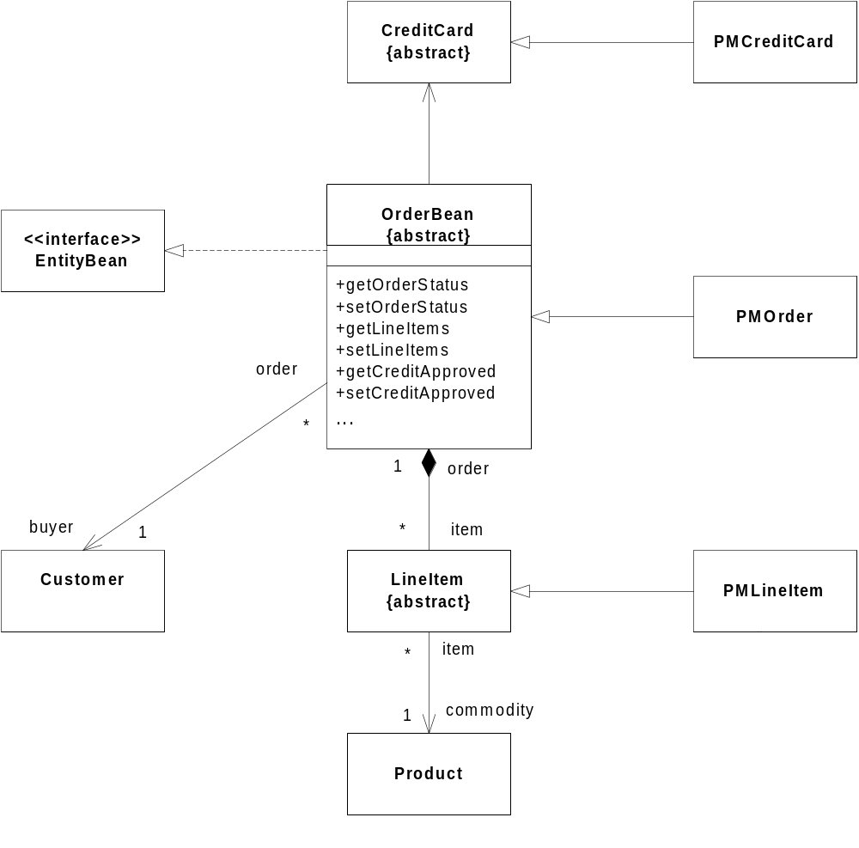
Class Diagram Example
Adapted from Fig. 23 [EJB 2.0].

Slide 57
Implementation Diagrams
Show aspects of model implementation, including source code structure and run-time implementation structure
Kinds
  component diagram
  deployment diagram

Slide 58
Component Diagram
Shows the organizations and dependencies among software components
Components may be
  specified by classifiers (e.g., implementation classes)
  implemented by artifacts (e.g., binary, executable, or script files)

Slide 59
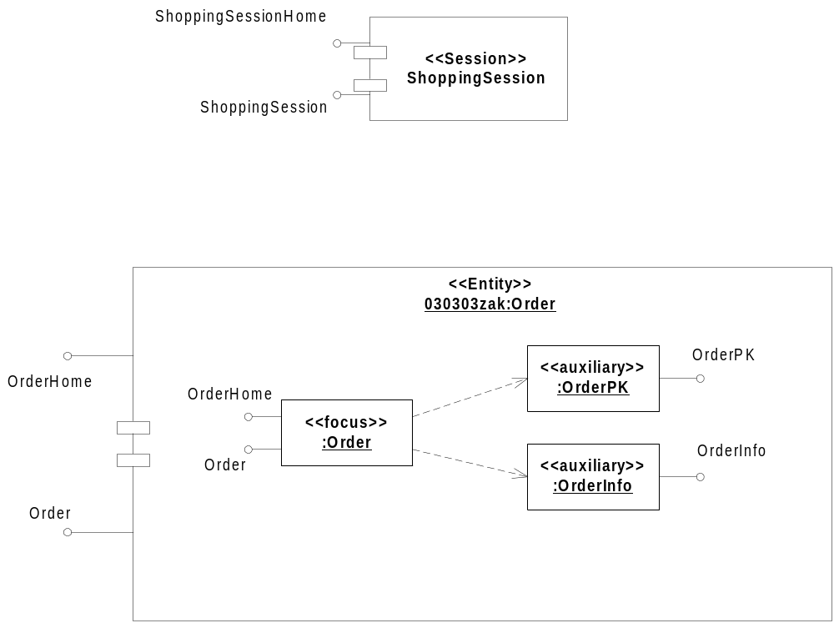
Components
Fig. 3-99, UML Notation Guide

Slide 60
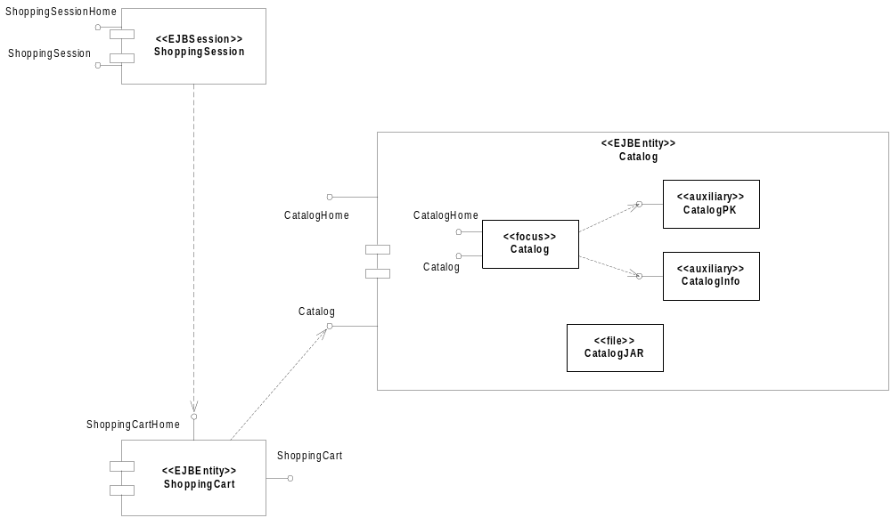
Component Diagram
Fig. 3-95, UML Notation Guide

Slide 61
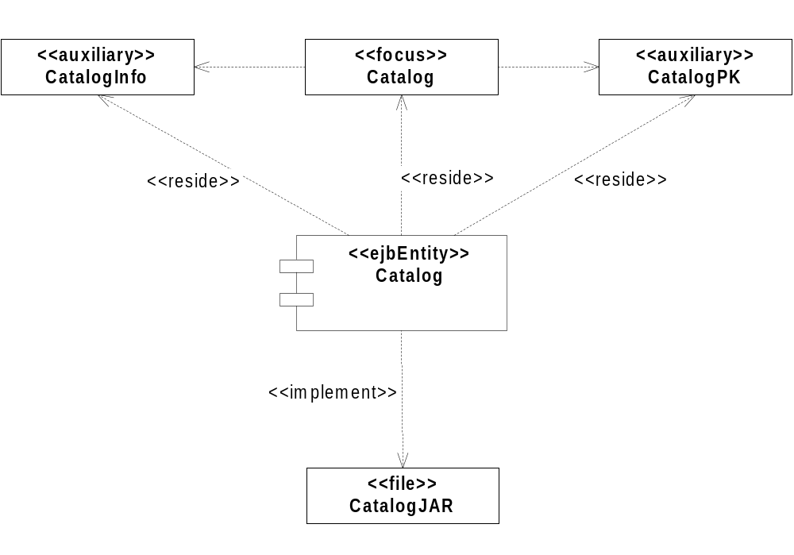
Component Diagram with Relationships
Fig. 3-96, UML Notation Guide

Slide 62
Deployment Diagram
Shows the configuration of run-time processing elements and the software components, processes and objects that live on them
Deployment diagrams may be used to show which components may run on which nodes

Slide 63
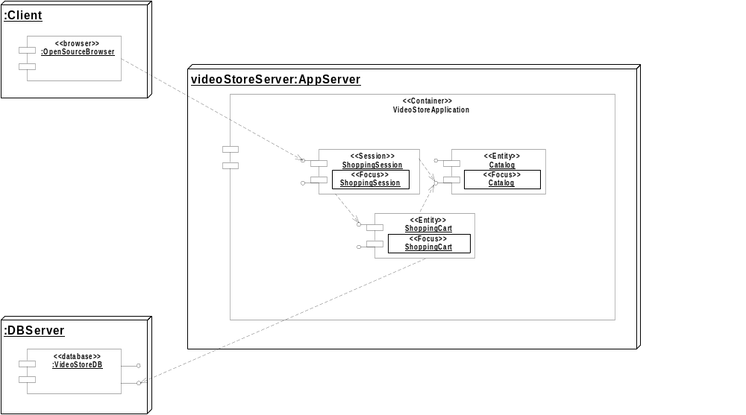
Deployment Diagram (1/2)
Fig. 3-97, UML Notation Guide

Slide 64
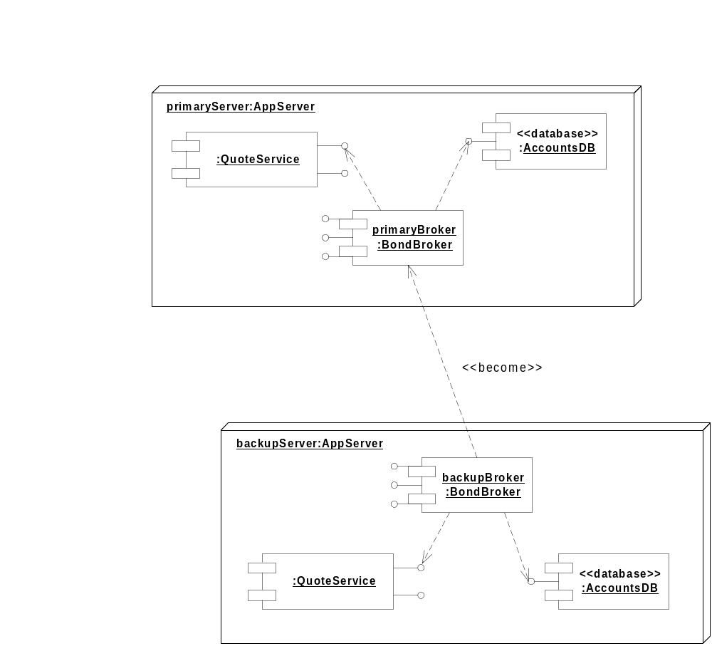
Deployment Diagram (2/2)
Fig. 3-98, UML Notation Guide

Slide 65
When to model structure
Adopt an opportunistic top-down+bottom-up approach to modeling structure
  Specify the top-level structure using “architecturally significant” classifiers and model management constructs (packages, models, subsystems; see Tutorial 3)
  Specify lower-level structure as you discover detail re classifiers and relationships
If you understand your domain well you can frequently start with structural modeling; otherwise
  If you start with use case modeling (as with a use-case driven method) make sure that your structural model is consistent with your use cases
  If you start with role modeling (as with a collaboration-driven method) make sure that your structural model is consistent with your collaborations

Slide 66
Structural Modeling Tips
Define a “skeleton” (or “backbone”) that can be extended and refined as you learn more about your domain.
Focus on using basic constructs well; add advanced constructs and/or notation only as required.
Defer implementation concerns until late in the modeling process.
Structural diagrams should
  emphasize a particular aspect of the structural model
  contain classifiers at the same level of abstraction
Large numbers of classifiers should be organized into packages (see Lecture 3)

Slide 67
Interface-Based Design
Interface-based design is a design approach that
  emphasizes the specification of system interfaces
  separates the specification of service operations (interfaces) from their realization (implementation)
CORBA IDL is typically used for interface-based design of CORBA applications
  defines interfaces for business and system objects without constraining their implementations
  defines the structure of an distributed application
  doesn’t allow you to specify object behavior or class relationships other than generalization

Slide 68
Interface-Based Design (cont’d)
The following example shows how UML can model the interfaces for a Point of Sale application originally specified in CORBA IDL. From [Kobryn 2000].

Slide 69
Example: Interface-based design
module POS
{
typedef long POSId;
typedef string Barcode;
interface InputMedia
{
typedef string OperatorCmd;
void barcode_input(in Barcode item);
void keypad_input( in OperatorCmd cmd);
};
interface OutputMedia
{
boolean output_text( in string string_to_print );
};
…..
Generic IDL Point of Sale (POS) example. [Siegel 00]

Slide 70
Example: Interface-based design
…..
interface POSTerminal
{
void login();
void print_POS_sales_summary();
void print_store_sales_summary();
void send_barcode( in Barcode item);
void item_quantity( in long quantity);
void end_of_sale();
};
};
#endif /* _POS_IDL_ */

Slide 71
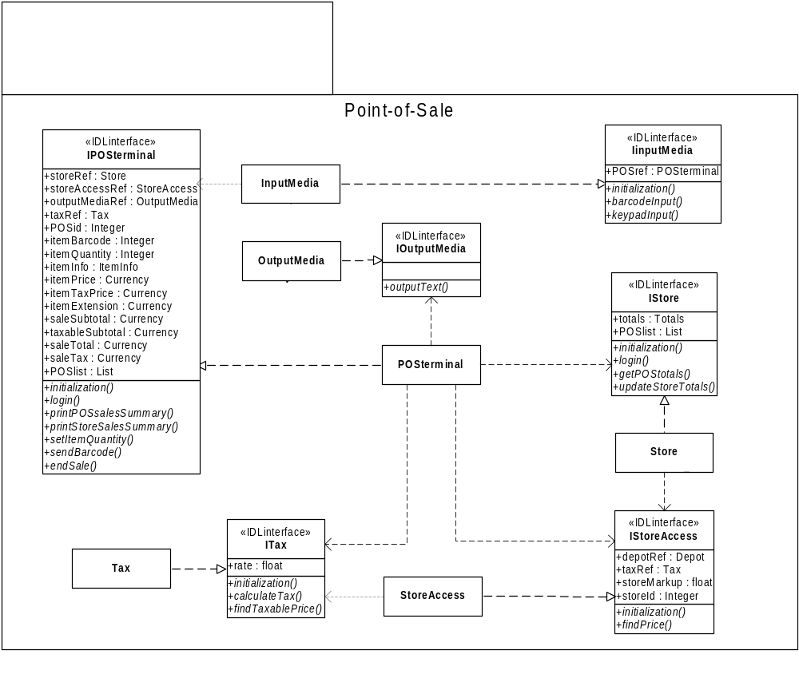
From [Kobryn 00].

Slide 72
Use Case Modeling
What is use case modeling?
Core concepts
Diagram tour
When to model use cases
Modeling tips
Example: Online HR System

Slide 73
What is use case modeling?
use case model: a view of a system that emphasizes the behavior as it appears to outside users. A use case model partitions system functionality into transactions (‘use cases’) that are meaningful to users (‘actors’).

Slide 74
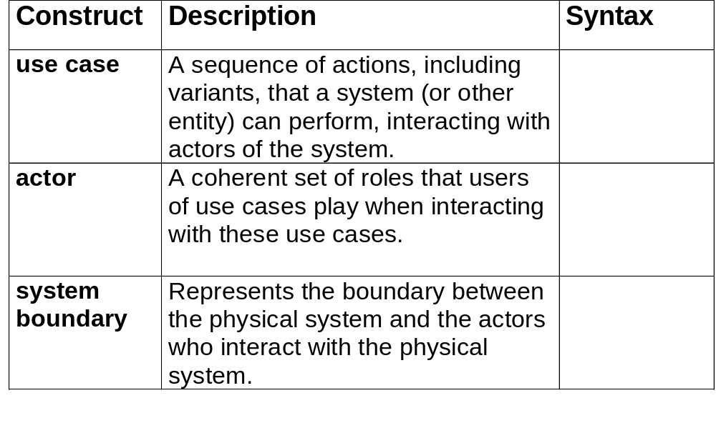
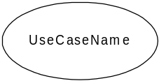
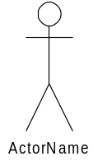

Use Case Modeling: Core Elements

Slide 75
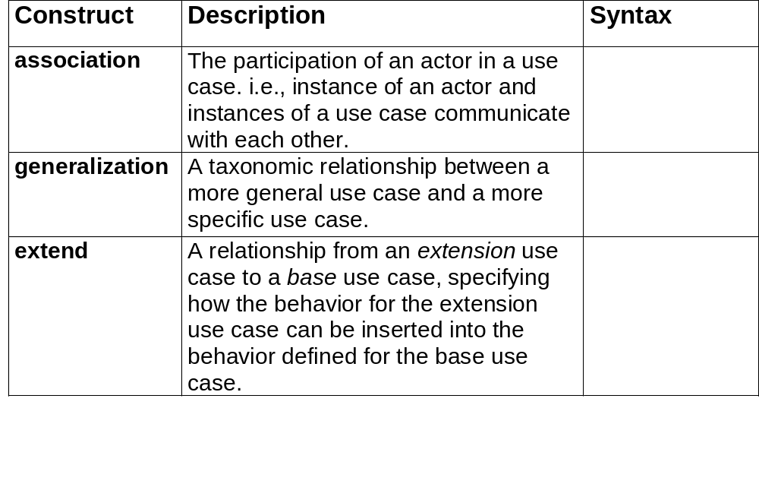

Use Case Modeling: Core Relationships
<<extend>>

Slide 76
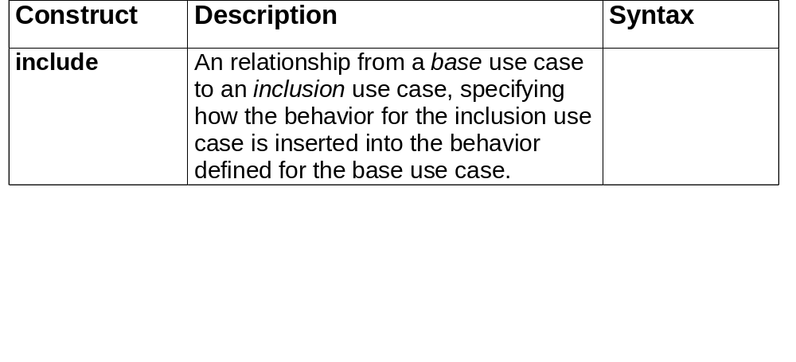
Use Case Modeling: Core Relationships (cont’d)
<<include>>

Slide 77
Use Case Diagram Tour
Shows use cases, actor and their relationships
Use case internals can be specified by text and/or interaction diagrams (see Lecture 2)
Kinds
  use case diagram
  use case description

Slide 78
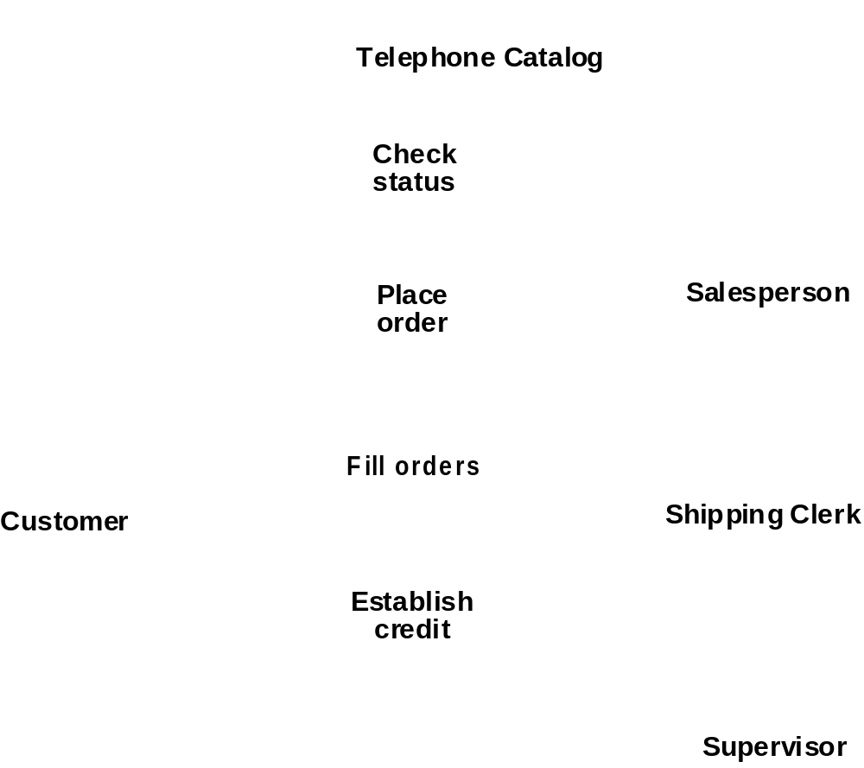
Use Case Diagram
Fig. 3-53, UML Notation Guide

Slide 79

Use Case Relationships
Fig. 3-54, UML Notation Guide

Slide 80

Actor Relationships
Fig. 3-55, UML Notation Guide

Slide 81
Use Case Description: Change Flight
Actors: traveler, client account db, airline reservation system
Preconditions:
  Traveler has logged on to the system and selected ‘change flight itinerary’ option
Basic course
  System retrieves traveler’s account and flight itinerary from client account database
  System asks traveler to select itinerary segment she wants to change; traveler selects itinerary segment.
  System asks traveler for new departure and destination information; traveler provides information.
  If flights are available then
  …
  System displays transaction summary.
Alternative courses
  If no flights are available then …

Slide 82
When to model use cases
Model user requirements with use cases.
Model test scenarios with use cases.
If you are using a use-case driven method
  start with use cases and derive your structural and behavioral models from it.
If you are not using a use-case driven method
  make sure that your use cases are consistent with your structural and behavioral models.

Slide 83
Use Case Modeling Tips
Make sure that each use case describes a significant chunk of system usage that is understandable by both domain experts and programmers
When defining use cases in text, use nouns and verbs accurately and consistently to help derive objects and messages for interaction diagrams (see Lecture 2)
Factor out common usages that are required by multiple use cases
  If the usage is required use <<include>>
  If the base use case is complete and the usage may be optional, consider use <<extend>>
A use case diagram should
  contain only use cases at the same level of abstraction
  include only actors who are required
Large numbers of use cases should be organized into packages (see Lecture 3)

Slide 84

Example: Online HR System

Slide 85

Online HR System: Use Case Relationships

Slide 86
Online HR System: Update Benefits Use Case
Actors: employee, employee account db, healthcare plan system, insurance plan system
Preconditions:
  Employee has logged on to the system and selected ‘update benefits’ option
Basic course
  System retrieves employee account from employee account db
  System asks employee to select medical plan type; include Update Medical Plan.
  System asks employee to select dental plan type; include Update Dental Plan.
  …
Alternative courses
  If health plan is not available in the employee’s area the employee is informed and asked to select another plan...

Slide 87
Wrap Up
Ideas to take away
Preview of next tutorial
References
Further info

Slide 88
Ideas to Take Away
UML is effective for modeling large, complex software systems
It is simple to learn for most developers, but provides advanced features for expert analysts, designers and architects
It can specify systems in an implementation-independent manner
10-20% of the constructs are used 80-90% of the time
Structural modeling specifies a skeleton that can be refined and extended with additional structure and behavior
Use case modeling specifies the functional requirements of system in an object-oriented manner

Slide 89
Preview - Next Tutorial
Behavioral Modeling with UML
  Behavioral modeling overview
  Interactions
  Collaborations
  Statecharts
  Activity Graphs

Slide 90
References
[UML 1.3] OMG UML Specification v. 1.3, OMG doc# ad/06-08-99
[UML 1.4] OMG UML Specification v. 1.4, UML Revision Task Force recommended final draft, OMG doc# ad/01-02-13.
[Kobryn 01a] C. Kobryn, “UML 2.0 Roadmap: Fast Track or Detours?,” Software Development, April 2001. To appear.
[Kobryn 01b] C. Kobryn, “Modeling Distributed Applications with UML,” chapter in [Siegel 01] Quick CORBA 3, Wiley, 2001. To be published.
[Kobryn 00] “Modeling CORBA Applications with UML,” chapter 21 in [Siegel 00] CORBA 3 Fundamentals and Programming (2nd ed.), Wiley, 2000.
[Kobryn 99] UML 2001: A Standardization Odyssey, Communications of the ACM, Oct. 1999.
[EJB 2.0] Enterprise JavaBeans Specification v. 2.0, Sun Microsystems, March 31, 2000.

Slide 91
Further Info
Web:
  UML 1.4 RTF: www.celigent.com/omg/umlrtf
  OMG UML Tutorials: www.celigent.com/omg/umlrtf/tutorials.htm
  UML 2.0 Working Group: www.celigent.com/omg/adptf/wgs/uml2wg.htm
  OMG UML Resources: www.omg.org/uml/
Email
  uml-rtf@omg.org
  ckobryn@acm.org
Conferences & workshops
  UML World 2001, New York, June 11-14, 2001
  UML 2001, Toronto, Canada, Oct. 1-5, 2001
  OMG UML Workshop 2001, San Francisco, Dec. 3-6, 2001

